Slide 1
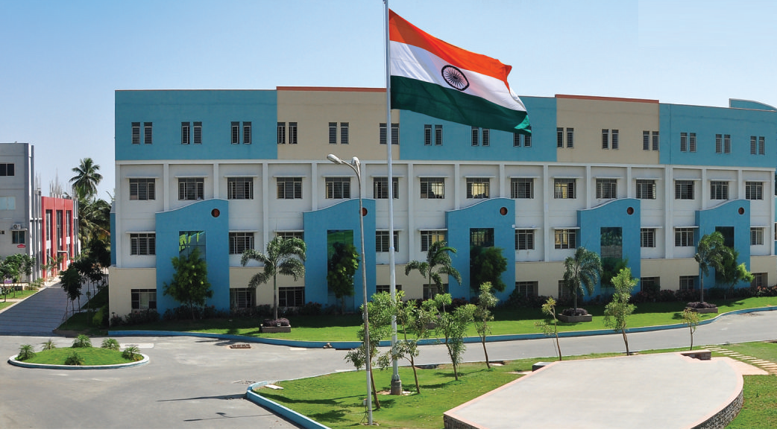
SRI ESHWAR COLLEGE OF ENGINEERING academic year: 2017-18 department : civil section : 4 -year
FINAL YEAR PROJECT REVIEW – 0th
Date of review: 7.07.2017

Slide 2
PLANNING,ANALYSIS AND DESIGN OF AUTOMATIC CAR PARKING SYSTEM
By,
K.JANANI
D.DEEPANANDHINI
M.MURUGANANTHAM
M.VENKATESH PRASATH
GUIDED BY,
Mr S.VIVEK
ASSISTANT PROFESSOR
SRI ESHWAR COLLEGE OF ENGINEERING

Slide 3
CONTENTS
Introduction
Need for Study
Literature review
Objectives
Study area
Methodology
Work plan

Slide 4
INTRODUCTION
The industrialization of the world rise in population enormosly , almost city development and mismanagement of available parking spaces has resulted in a number of parking related problems
So implement an automated car parking system will increase safe and secured of parking system

Slide 5
Objective
Reduces the human effort and time for parking
Creating a cost – effective parking system
Safe and secure transportation can be acheived

Slide 6
NEED FOR STUDY
Our project will be implement on “UKKEDAM-SARAVANA STORE
REASON:
Heavy traffic
No proper planning
To reduce the parking area

Slide 7
LITERATURE REVIEW
S.No | Title | Journal /Author/Year | Description
1 | how Automated Parking Systems Work | International journal of car parking ,vol 10,issue3 pg 253-265 /a b Patrascu, Daniel /2010 | Removing the driver and passengers from the car before it is parked .the automatic machine to take the cars and then parked the at the empty place.
2 | Automated Car Parking | International journal of car parking,vol 10,issue 3 pg 47-55 / A. Wafa , N.Zeba/ 2012 | Design procedure is influenced by the parking purpose how frequently consumer’s visit ,payment and control system
3 | RFID-Based Automated Vechicle Parking System | International journal of Engineering Reasearch and Application,volume 4/ pg 9-25B/Waraich | In this paper describe sensor can be used and to detect the available parking place

Slide 8
S.no | Title | Journal /Author/Year | Description
4 | “De-Mystifying Automated Parking Structures” | International journal of car parking vol 13 pg-385-399/ Mohan, Don/2011 | Various modern technique such as wireless sensor ,logical GPS based and vision based e parking can decrease related issues.
5. | “Rotary Automated Car Parking System” | International journal of car parking vol 17 issues1/C.Patel,M.Swami,P.Saikia,S.Shah/2015 | Developed to utilize maximum vertical area in the available minimum ground level.
6 | Automatic Robotic car parking system | International journal of car parking vol 19 issues2/Figg J W /2011 | The robotic car parking system which transfer the car one trolley to another trolley

Slide 9
S.No | Title | Journal/Author/Year | Description
8 | “Safe Parking:What You Should Do to Protect Employees and Guests” | International journal of emerging technology and advanced engi.vol 7 issues4/Atlas.Randall I/2010 | It gives knowlede about how the employee park the car in aloted place
9 | “multistorey car park design project” | International journal of emerging technology and advanced engi.vol 9 issues4Anyangu Harris Amunga/2009 | Multi car park design for car parking with a number of floors and levels on which parking takes place .
10 | “Modelling a multi-car Elevator System using Witness” | International journal of emerging technology and advanced engi.vol 10 issues4 O.Omar,M.Latif, and M.Awais/2013 | The proposed system and algorithm enables car driver to find the most appropriate parking lot

Slide 10
METHODOLOGY
By using “Auto CAD” software planning the parking system
By using “STAAD Pro.” software planning the parking system
By using “Revit Architecture” software planning the parking system
By using “Primavera” software planning the parking system

Slide 11
REFERENCE
A.Wafa,N.Zeba,”Automated Car Parking”,2012.
C.Patel,M.Swami,P.Saikia,S.Shah,”Rotary Automated Car Parking System", Volume 4,March 2015.
B.Waraich ,”RFID-Based Automated Vehicle Parking System”.
Mohan,Don (2011), “De-Mystifying Automated Parking Structures", PowerPoint Presentation: 8,retrieved 2012-11-15
“Road to Robotic Parking is Littered with Faulty Projects, 2015,retrieved 2015-11-30

Slide 12
Atlas.Randall I,(2010),”Safe Parking:What You Should Do to Protect Employees and Guests”(PDF), International Parking Institute (March), archieved from the original(PDF) on 2011-05-16
a b Patrascu, Daniel (2010), “how Automated Parking Systems Work “,Auto evolution, retrieved 2012-11-16
Design recommendations for multi- storey and underground car Park”, Institution of structural Engineers
Guidelines for the Design of Off-Steet Car Parking Facilities.
“MULTISTOREY CAR PARK DESIGN PROJECT”By Anyangu Harris Amunga:F16/29850/2009”

Slide 13
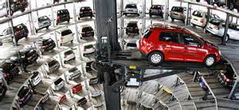

Slide 14
QUERIES??...

